Slide 1


Cameron County – CCRMA
US77 – US281
Rio Grande Valley Interstate Connectivity
David A. Garza - Cameron County Commissioner, Pct. 3
TXDOT I-69 Advisory Committee Member
I-69 Alliance Exe. Com. Sec/Tre
December 4, 2019

Slide 2
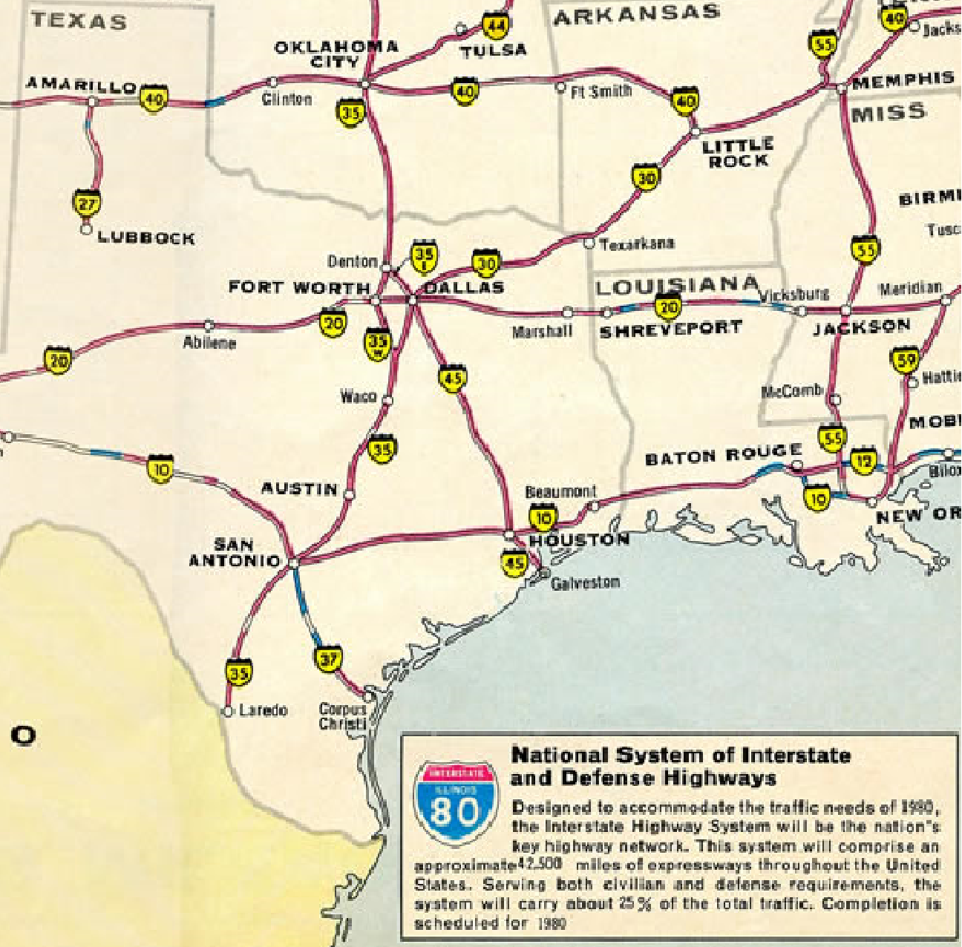
Pre-2000
Regional Needs:
No Interstate Connectivity to the region
No Designated segments in the region
Ongoing Development:
No activity on either the US77 or US281 corridor

Slide 3
2001-2007
Regional Needs:
No Interstate Connectivity to the region
No Designated segments in the region
Ongoing Development:
Cameron County and CCRMA begin to establish a presence at the TxDOT commission.
Cameron County and CCRMA attend all TxDOT Public Involvement for US77 / US281
First stages of partnerships with Willacy, Kenedy, Kleberg and Nueces County and TxDOT.

Slide 4
2008-2010
Regional Needs:
No Interstate Connectivity to the region
No Designated segments in the region
Ongoing Development:
March 2008, the Texas Transportation Commission authorized the creation of an I-69 Advisory Committee. This committee, composed of volunteers from I-69 corridor communities, advises TxDOT on I-69 issues and priorities and engages regional and local stakeholders on I-69 status and project development.
South to North Designation Strategy Developed.

Slide 5
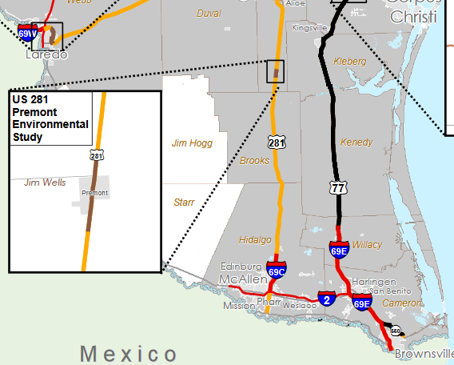
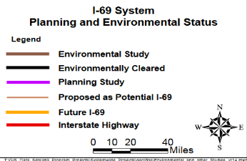
2010 - 2015
Regional Needs:
No Interstate Connectivity to the region
Ongoing Development:
US 77 corridor environmentally cleared
Highways identified by Congress to be part of the national interstate system, such as I-69, must meet FHWA interstate design standards
In conjunction with TxDOT a South to North approach was developed since many existing facilities in the Rio Grande Valley were already constructed to Interstate Standards.
Several Segments were submitted to FHWA for approval and were subsequently designated.
  I-69, I-69W, I-69C, I-69E, I-169 and I-369.

Slide 6
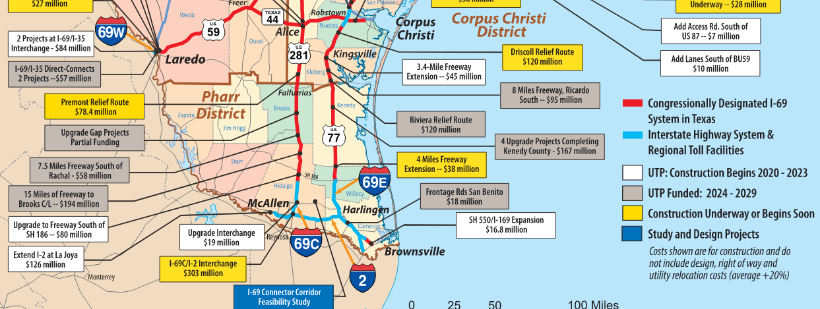
2015-2020
Regional Needs:
Interstate Connectivity to the North
Ongoing Development:
US77 - $450 M under Dev/Construction
US281 - $970 M under Dev/Construction
Efforts to add additional 2021UTP Funding

Slide 7
2021 UTP
Regional Needs:
Interstate Connectivity to the North
Ongoing Development:
US77 - $125 M Additional Funding
US281 - $480 M Additional Funding

Slide 8
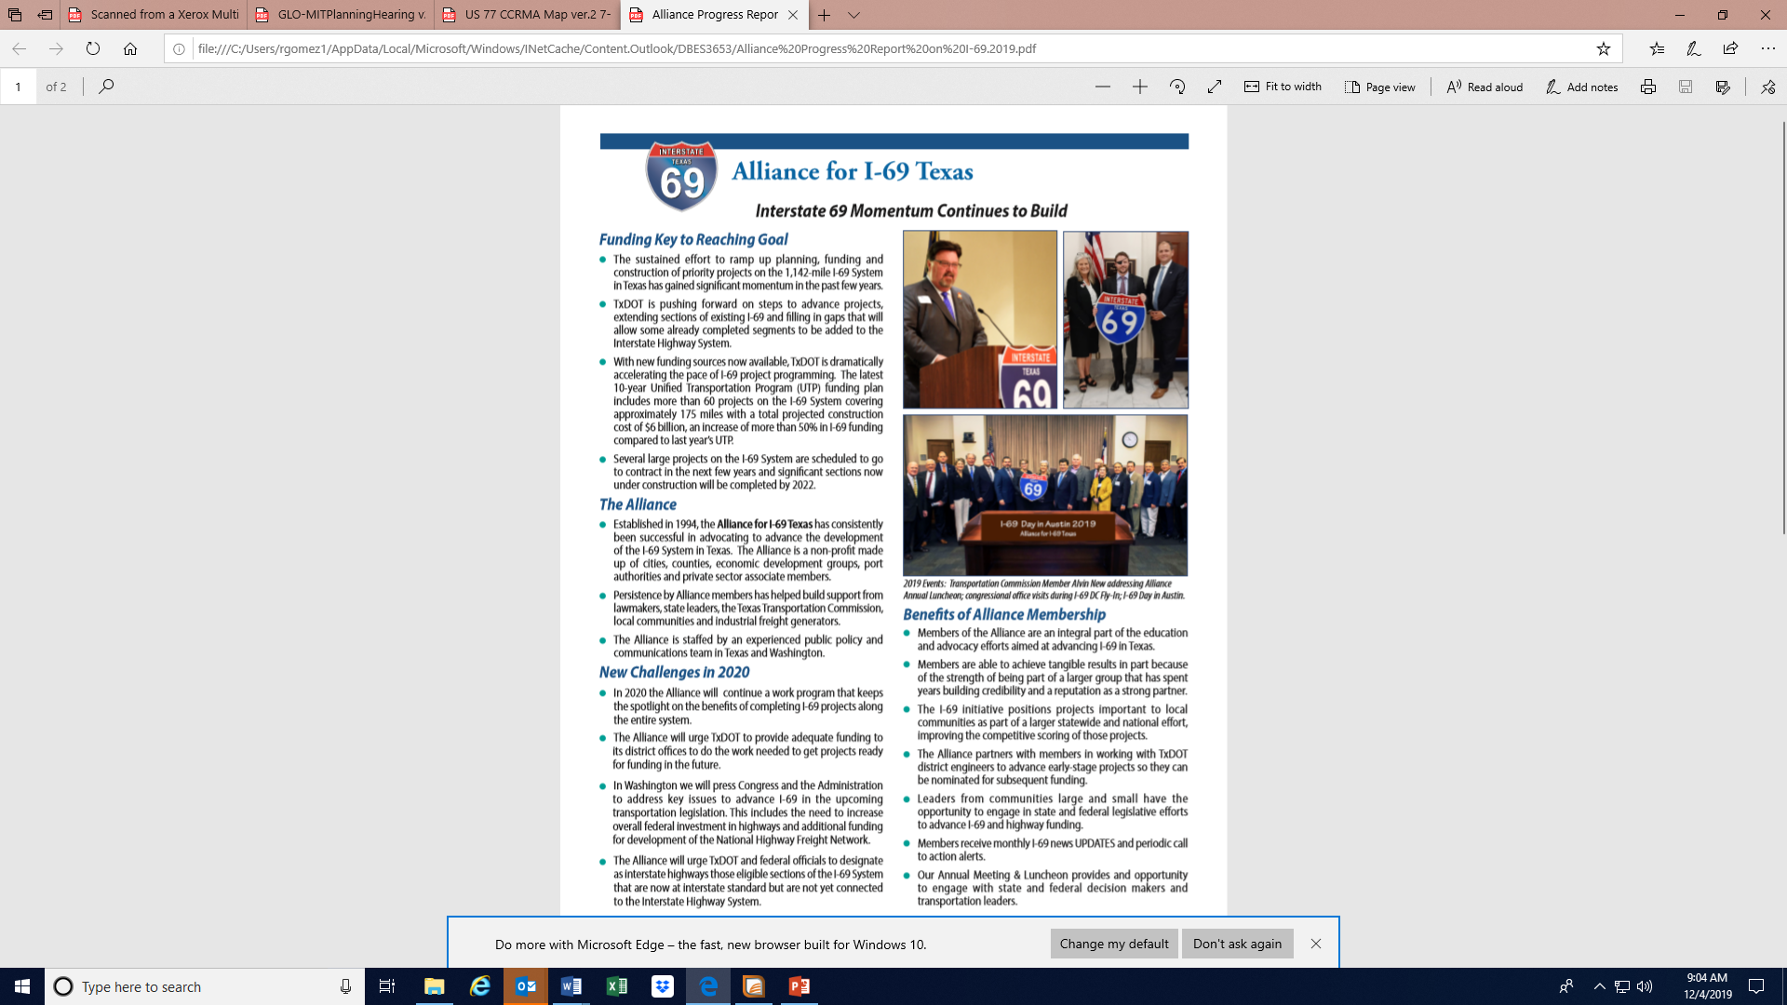
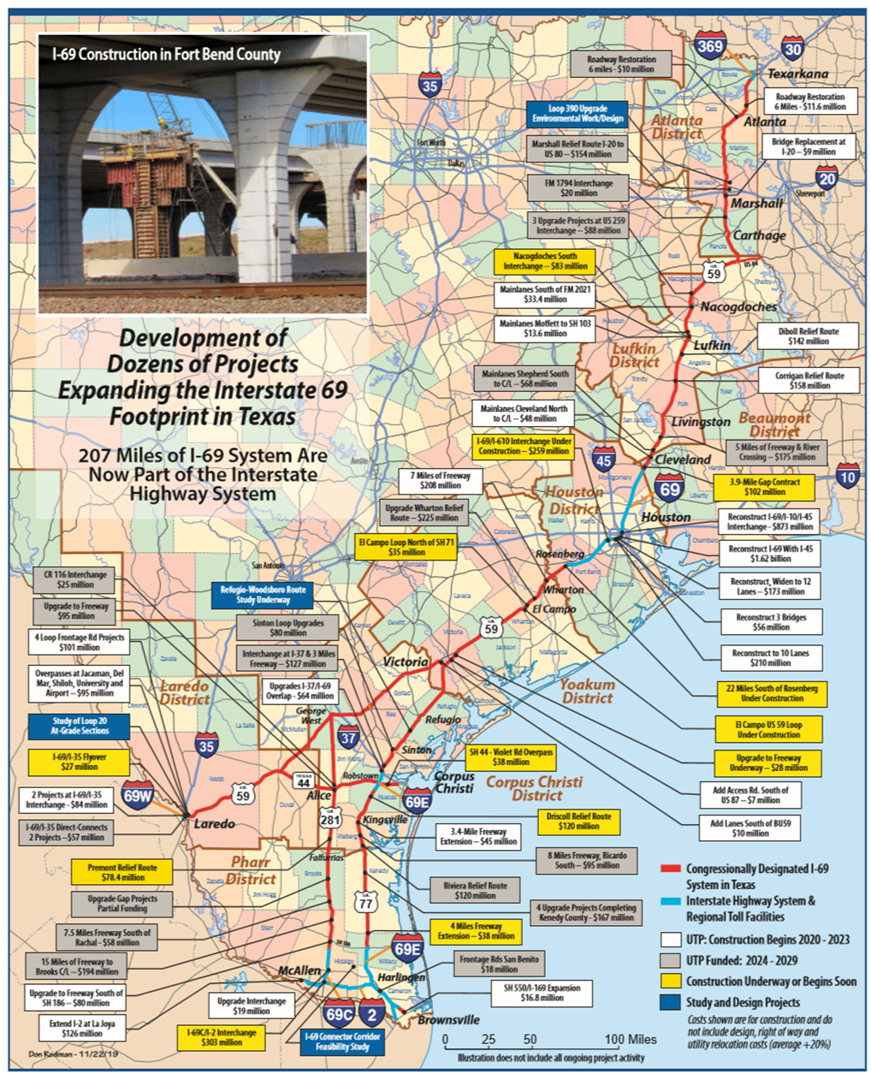
I–69 Alliance December Update and Progress Report

Slide 9
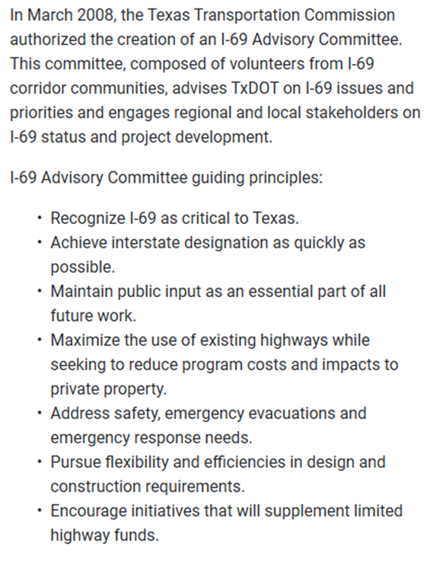
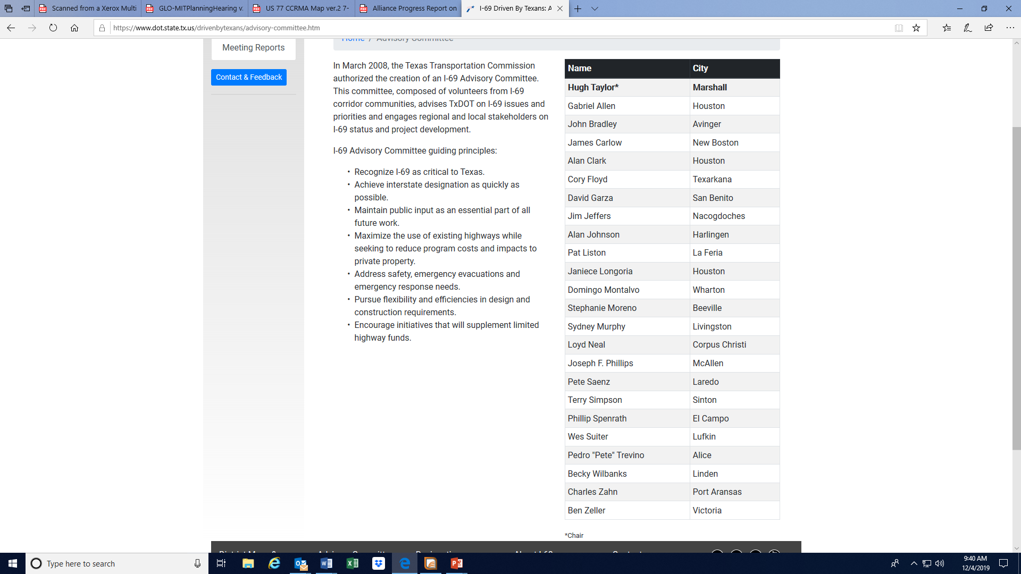
I-69 Advisory Committee

Slide 10
I-69 Alliance Executive Committee
Sydney Brown Murphy County Judge Polk County Chairman | Sergio Contreras President & CEO Rio Grande Valley Partnership | Billie Jones Director of Special Programs/Projects Wharton Chamber of Commerce | David Garza Commissioner Cameron County
Barbara Canales County Judge Nueces County | Charlie Zahn Chairman Port of Corpus Christi | James Carlow County Judge Bowie County | Gerry Schwebel Executive Vice President International Bank of Commerce
Roger Guenther Executive Director Port of Houston Authority | Charles Thomas Executive Director Carthage Improvement Corp. | Jim Jeffers City Manager City of Nacogdoches | Bob Harvey President & CEO Greater Houston Partnership

